Slide 1
Managing Business Knowledge
Managing and Using Information Systems: A Strategic Approach
by Keri Pearlson & Carol Saunders

Slide 2
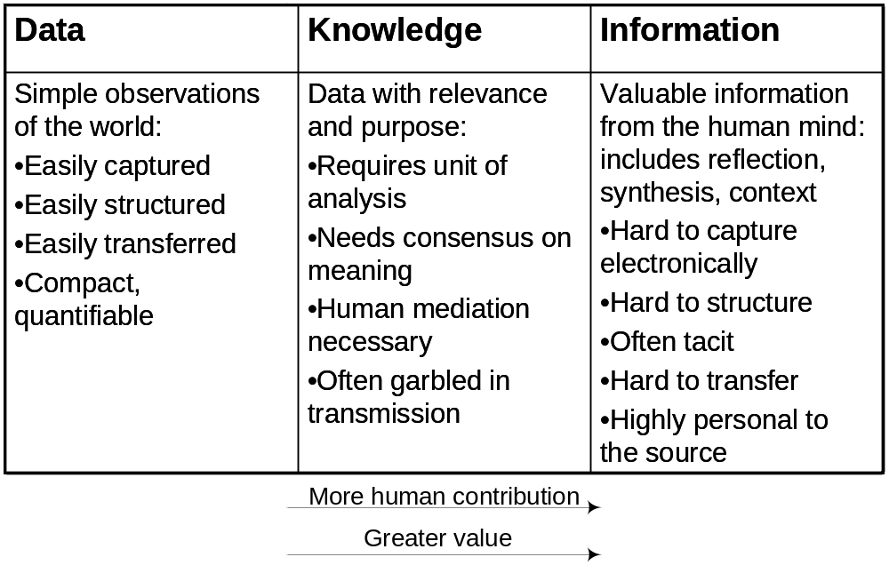
Figure 12.1 The relationships between data, information, and knowledge.

Slide 3
Knowledge
Knowledge is a mix of contextual information, experiences, rules, and values.
Richer, deeper, and more valuable.
Consider knowing –
  What? - based upon assembling information and eventually applying it.
  How? – applying knowledge leads to learning how to do something.
  Why? – casual knowledge of why something occurs.
  (Figure 12.2 graphically illustrates these types of knowing).

Slide 4
Tacit vs. Explicit Knowledge
Tacit knowledge is personal, context-specific and hard to formalize and communicate
  A [knowledge] developed and internalized by the knower over a long period of time . . . incorporates so much accrued and embedded learning that its rules may be impossible to separate from how an individual acts. ‘knowing how’
Explicit knowledge can be easily collected, organized and transferred through digital means.
  A theory of the world, conceived of as a set of all of the conceptual entities describing classes of objects, relationships, processes, and behavioral norms. Often referred to as ‘knowing that’, or declarative knowledge.
See Figure 12.3 for more examples.

Slide 5
Tacit Knowledge Knowing how to identify the key issues necessary to solve a problem Applying similar experiences from past situations Estimating work required based on intuition & experience Deciding on an appropriate course of action
Explicit Knowledge Procedures listed in a manual Books and articles News reports and financial statements Information left over from past projects
Figure 12.3 Examples of explicit and tacit knowledge

Slide 6
From Managing Knowledge to BI
Managing knowledge is not a new concept, but one reinvigorated by IT.
KM is still an emerging discipline
Business Intelligence (BI) term used to describe the set of technologies and processes used to describe business performance.
  BI is a component of KM.
Business Analytics – use of quantitative and predictive models, and fact based mgmt to drive decisions.
An organization’s only sustainable competitive advantage lies with how its employees apply knowledge to business problems
KM is not a magic bullet.

Slide 7
Why Manage Knowledge?
Information and knowledge have become the fields in which businesses compete.
Several important factors include:
  Sharing Best Practice
  Globalization
  Rapid Change
  Downsizing
  Managing Information and Communication Overload
  Knowledge Embedded (inclure) in Products
  Sustainable Competitive Advantage
  Figure 12.4 summarizes these trends.

Slide 8
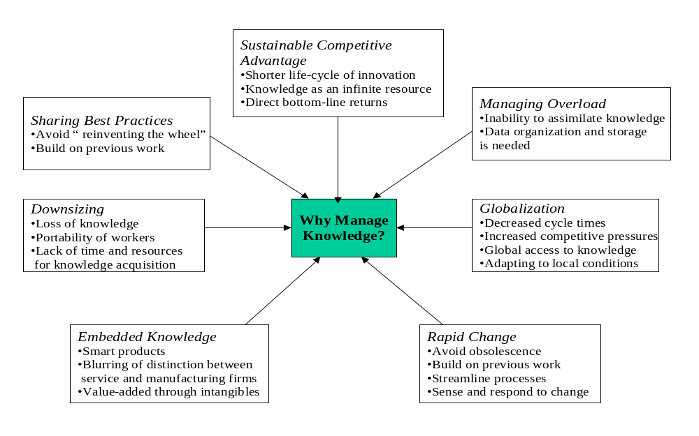
Figure 12.4 Reasons for Managing Knowledge. ©IBM Global Services
- Avec en plus la rareté de la m-o
- Lien IA pour définir les algorithmes
Strategy view
Top 3 today ?

Slide 9
Sharing Best Practices
Sharing best practices means leveraging the knowledge gained by a subset of the organization.
Increasingly important in organizations who depend on applying their expertise such as accounting, consulting and training firms.
KM systems capture best practices to disseminate their experience within the firm.
Problems often arise from employees who may be reluctant to share their knowledge (managers must encourage and reward open sharing).

Slide 10
Globalization
Historically three factors, land, labor and capital were the key to economic success
Knowledge has become a fourth factor.
Knowledge-based businesses can grow without traditional land, labor, and capital requirements.
Key competitive factor will be how well an organization acquires and applies knowledge.

Slide 11
Other factors
Rapid change: firms must be nimble (agile) and adaptive to compete
Downsizing: sometimes the wrong people get fired when creating a leaner organization
Managing Info and Comm Overload: data must be categorized in some manner if it is to be useful rather than overwhelming
Knowledge Embedded (intégré) in Products: the intangibles that add the most value to goods and services are becoming increasingly knowledge-based
Sustainable Competitive Advantage: KM is the way to do this. Shorter innovation life cycles keep companies ahead of the competition.

Slide 12
Designing Knowledge Maps
A knowledge map (see figure 12.6) serves as both a guide to where knowledge exists in an organization and an inventory of the knowledge assets available.
A knowledge map can consist of nothing more than a list of people, documents, and databases telling employees where to go when they need help.
Provides access to resources that would otherwise be difficult or impossible to find
Can capture tacit knowledge through narratives.
  Good stories are effective for knowledge transfer.

Slide 13
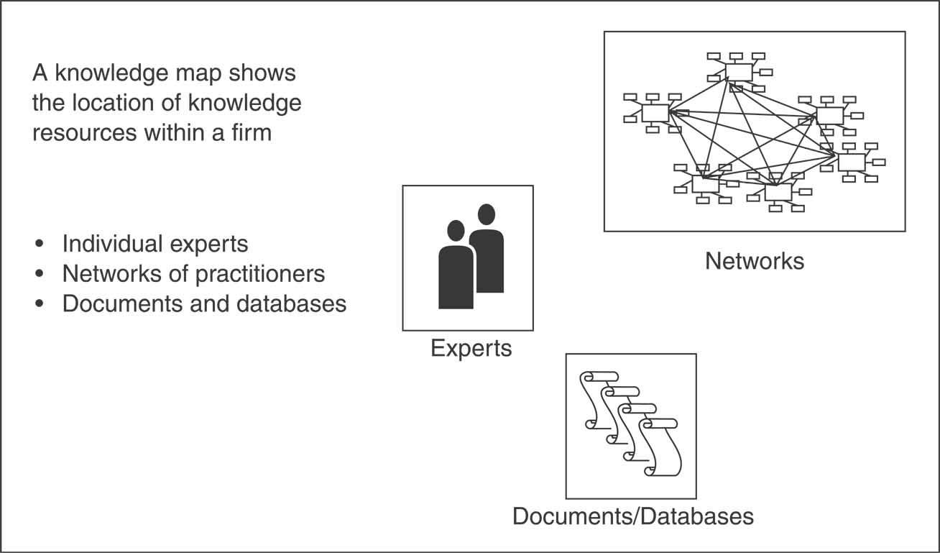
Figure 12.6 Contents of knowledge maps

Slide 14
Knowledge Transfer
Nonaka and Takeuchi’s Knowledge Transfer describe four different modes of knowledge conversion (transfer):
  Socialization: from tacit knowledge to tacit knowledge
  Externalization: from tacit knowledge to explicit knowledge
  Combination: from explicit knowledge to explicit knowledge
  Internalization: from explicit knowledge to tacit knowledge

Slide 15
COMPETING WITH BUSINESS ANALYTICS

Slide 16
Business Analytics
Davenport and Harris suggest that companies who are successful competing with business analytics have these five capabilities:
  Hard to duplicate
  Uniqueness
  Adaptability
  Better than competition
  Renewability

Slide 17
COMPONENTS OF
BUSINESS ANALYTICS

Slide 18
Component | Definition | Example
Data Repository | Servers and software used to store data | Data warehouses
Software Tools | Applications and processes for statistical analysis, forecasting, predictive modeling and optimization. | Data mining process; Forecasting software package
Analytics Environment | Organizational environment that creates and sustains the use of analytics tools | Reward system that encourages the use of the analytics tools; willingness to test or experiment
Skilled Work Force | Work force that has the training, experience and capability to use the analytics tools | Harrahs and Capital One have such work forces
Figure 12.8 Components of Business Analytics

Slide 19
Components of Business Analytics
Data repositories - data warehouses sometimes serve as repositories of organizational knowledge.
Software Tools – data mining is used to analyze data in the data warehouse looking for “gems”.
  Four categories of tools used:
    Statistical analysis
    Forecasting/extrapolation
    Predictive modeling
    Optimization

Slide 20
Components of Business Analytics
Analytics Environment – alignment of corporate culture.
  Incentive system
  Metrics used to measure success of initiatives
  Processes for using analytics
Skilled work force – experts are needed.
  Managers must set the example (CEO-level sponsorship).
  Require decisions be made using analytics.

Slide 21
Summary
KM is related to information systems in three ways: IT makes up its infrastructure, KM makes up the data infrastructure for many IS and apps, and KM is often referred to as an app of IS.
Data, information, and knowledge should not be seen as interchangeable.
The 2 kinds of knowledge are tacit and explicit.
Manage knowledge carefully, there are many valid and of course legal reasons.
KM projects can be measured using project-based measures.

